Slide 1
Waves
MS864M

Slide 2
What is a wave?
A waves is a disturbance that propagates from one region of the system to another.
Waves that require a medium to travel are known as mechanical waves.
Examples include ripples on a pond and musical sounds.
Waves that do not require a medium to travel are non-mechanical waves. Example include electromagnetic waves.
Waves animation

Slide 3
Wave propagation
All waves travel with a definite speed known as wave speed.
The medium itself does not travel through space.
The individual particles in the medium undergo either back and forth motion or up-down motion around their equilibrium positions.
Waves transport energy from one region to another but not the matter.

Slide 4
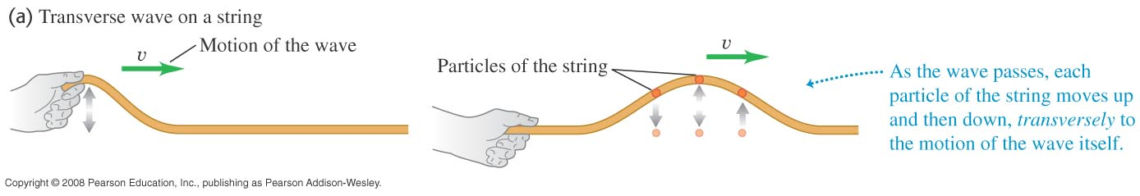
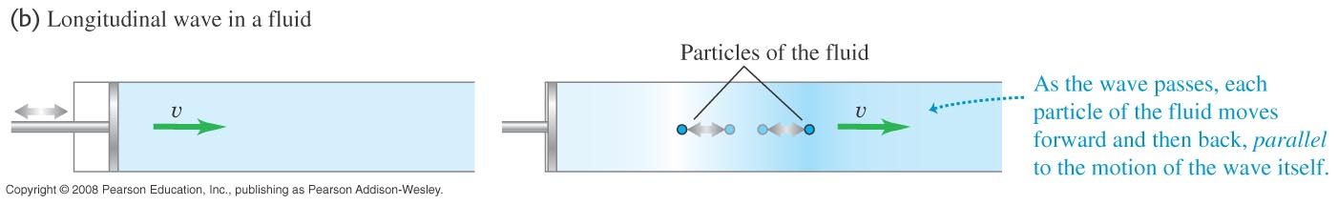
Types of waves
Waves that travel perpendicular to the motion of the particles in the medium are transverse waves.
Waves that travel in the same direction as the motion of the particles in the medium are longitudinal waves.
animations

Slide 5
Sinusoidal waves
If the hand in the figure moves up an down periodically, each particle on the string also undergoes periodic motion as the wave propagates.
Such a wave is known as a periodic wave.
Periodic waves in which the particles move with simple harmonic motion are known as sinusoidal waves.

Slide 6
Wavelength, frequency and speed
In a transverse wave, the wavelength (λ) is the distance between consecutive troughs or crests.
In a longitudinal wave, the wavelength (λ) is the distance between consecutive regions of compression or rarefaction.
The wave speed is given by v = f λ.
The wave speed depends only the mechanical properties of the medium.

Slide 7
Example 1
What is the wavelength of sound of frequency 262 Hz? Take the speed of sound to be 344 m/s.
Notes:
Wavelength = 1.31 m

Slide 8
Wave function
During the wave motion on a string, a particle is displaced some distance y in the direction perpendicular to x-axis.
The function y(x, t) is called as the wave function.
The wave function describes the displacement of any particle from its equilibrium position at any time.

Slide 9
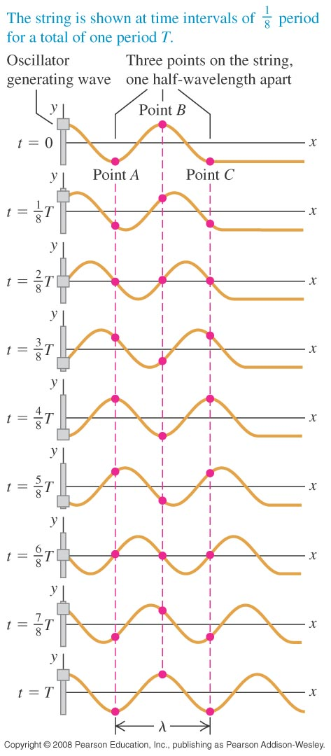
Phase differences
In a sinusoidal wave every particle oscillates in SHM with the same amplitude and frequency.
The oscillation of particles are out of step with each other.
These differences are known as phase differences.

Slide 10
Wave function for a sinusoidal wave
Let the displacement of a particle at the origin (x = 0) to the left end of a string be
At t = 0, the particle is at its maximum displacement A and is instantaneously at rest.

Slide 11
Wave function for a sinusoidal wave
The wave travels from x = 0 to some point x to the right in a time x/v where v is the wave speed.
The motion of point x at time t is the same as the motion of point x = 0 at the earlier time t – x/v.
The displacement of point x can be obtained by replacing t by t – x/v as in the following equation
The above is the wave function for a sinusoidal wave moving in the positive x-direction .

Slide 12
Wave number
The wave equation can be written in terms of the period and wavelength as
We define the wave number k as
Since ω = 2π/T, the wave function becomes

Slide 13
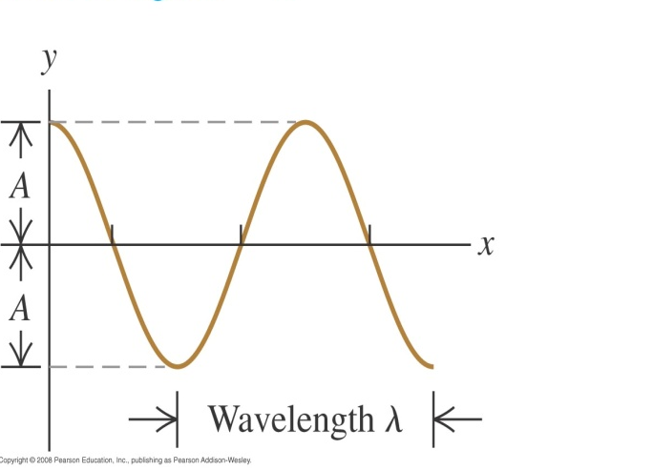
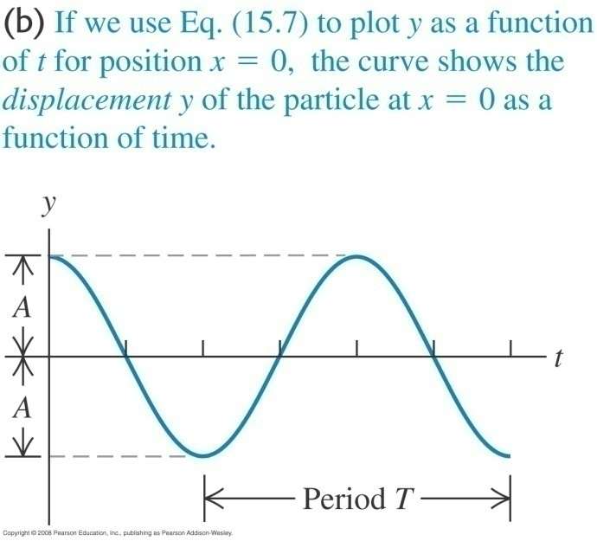
Graphing a wave
The first figure shows the wave as a function of x for a specific time t.
The second figure shows the wave as a function of t for a specific coordinate x.

Slide 14
Wave function for a wave travelling to the left
Suppose a wave travels from x = 0 to some point x to the left of the origin in a time x/v.
The motion of point x at time t is the same as the motion of point x = 0 at the later time t + x/v.
The displacement of point x can be obtained by replacing t by t + x/v as in the following equation

Slide 15
Phase velocity
The quantity ( kx ± ωt) is called the phase.
Its value for any x and t determines what part of the sinusoidal cycle is occurring at a particular point and time.
For a crest (y = A) the phase could be 0, 2π, 4π and so on while for a trough (y = -A), the phase could be π, 3π and so on
The quantity dx/dt = ω/k is known as the phase velocity of the wave

Slide 16
Tranverse velocity and acceleration
The transverse velocity of the particle v_{y} is given by
The maximum transverse velocity is ωA.
The transverse acceleration of the particle a_{y} is given by

Slide 17
Wave equation
Taking the partial derivative w.r.t. x
If we divide the above equation with the acceleration, we get

Slide 18
Wave equation is applied in several scenarios
Whenever the wave equation occurs we know that the wave propagates along the x-axis with wave speed v.
The electric and magnetic fields also obey the wave equation and the wave speed turns out to be the speed of light.
This led to the conclusion that light is an EM wave.
The concept of wave function also applies to longitudinal waves.

Slide 19
Example 2
A man is playing with the clothesline. He unties one end, holds it taut and wiggles the end up and down sinusoidally with frequency 2.00 Hz and amplitude 0.075 m. The wave velocity is +12.0 m s⁻¹. At t = 0 the end has maximum positive displacement and is instantaneously at rest. Assume no wave bounces back from the far end to muddle up the pattern.
a) Find the amplitude, angular frequency, period, wavelength and wave number of the wave.
b) Write a wave function describing the wave.
c) Write equations for the displacement as a function of time of the man’s end of the clothesline and of a point 3.00 m from his end.
Notes:
A = 0.075 m, ω = 12.6 rad/s, T = 0.500 s, λ = 6.00 m, k = 1.05 rad/m
y(x,t) = (0.075 m) cos [ (1.05 rad/m)x – (12.6 rad/s)t]
y(x = 0,t) = (0.075 m) cos [ (12.6 rad/s)t], y(x = 3.00 m,t) = – (0.075 m) cos [(12.6 rad/s)t]

Slide 20
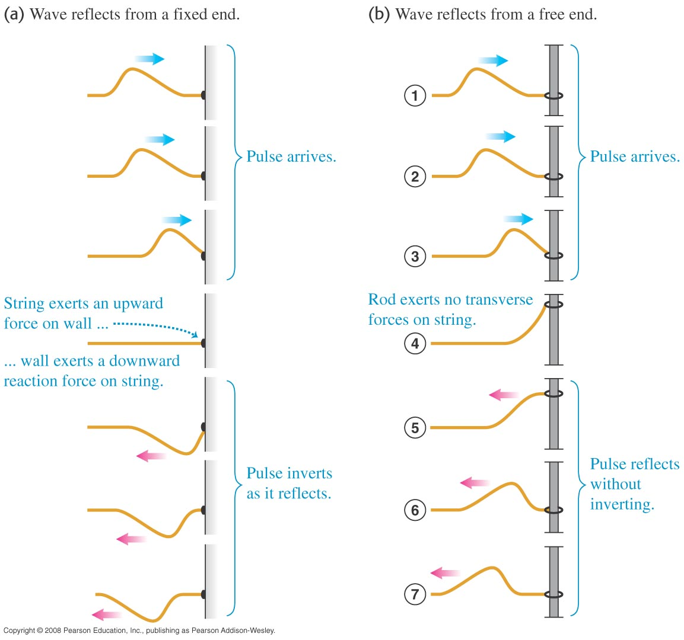
Reflection of waves
The reflected wave depends on the types of boundaries.
When there is an overlap between the ongoing and reflected wave, we have interference of the waves. Animation

Slide 21
The Principle of superposition
The superposition principle states that when two waves overlap, the displacement of any point at any time is obtained by adding the displacement the point would have if only the first wave were present and the displacement the point would have if only the second wave were present.
The combined wave function y(x, t) is therefore
Animations

Slide 22
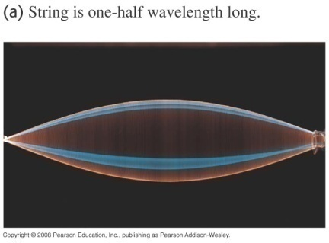
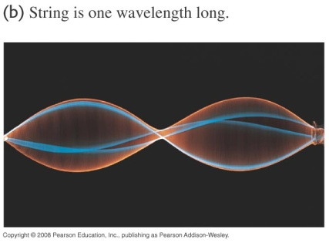
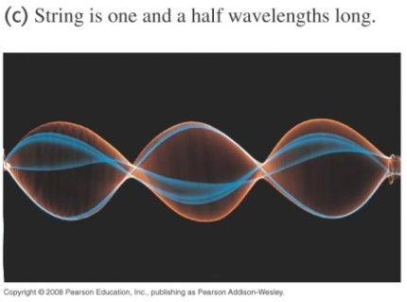
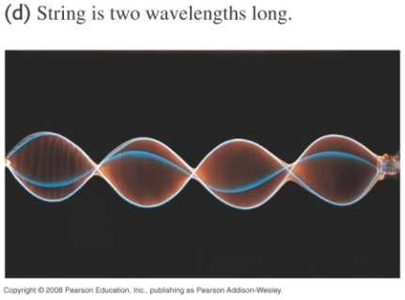
Standing waves
When an incident wave and the reflected wave combine, the wave pattern remains in the same position along the string and its amplitude fluctuates.
This kind of a wave pattern is known as a standing wave. A standing wave is unlike the travelling wave where the wave pattern moves with the wave speed.
Animations

Slide 23
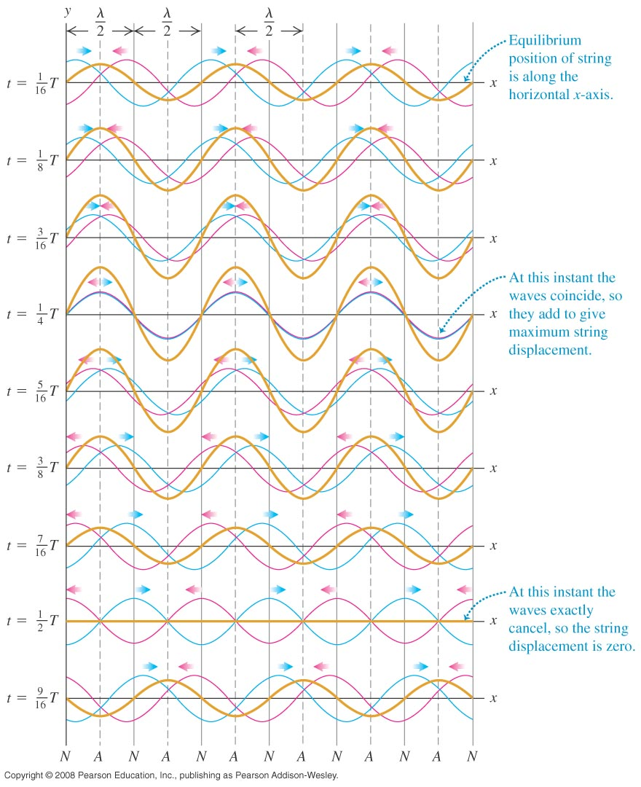
Constructive and destructive interference
At some points the displacements of the waves are identical and adding them makes the largest displacements. This is called as constructive interference.
At some points the displacements of the waves cancel out each other. This is called destructive interference.

Slide 24
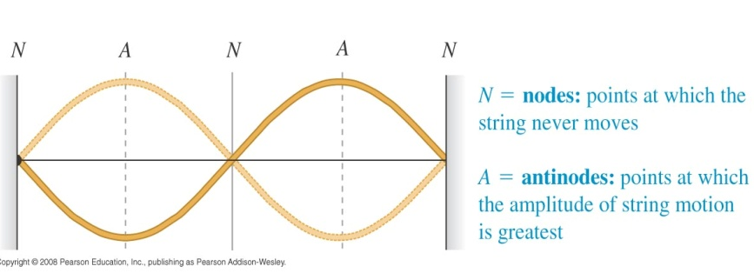
Nodes and antinodes
The points that do not move at all are known as nodes.
Midway between the nodes are points known as antinodes where the amplitude of motion is greatest.

Slide 25
Nodes and antinodes
The distance between successive nodes and antinodes is one half-wavelength.
Let there be a wave with a wave function y₁(x, t) and the reflected wave have a wave function y₂(x, t).
We consider a scenario in which the reflected wave is inverted so we give a negative sign to one of the waves.
Let

Slide 26
Mathematics of standing waves
The wave function for the standing wave is
A_{sw} is the amplitude of the standing wave on a string that is fixed at one end.
A_{sw} can have a value that is twice the amplitude of the original travelling waves.
The factor 2Asin(kx) shows that at each instant, the shape of the string is a sine curve.

Slide 27
Properties of standing waves
The wave shape stays in the same position oscillating up and down as described by the sin(ωt) factor.
Each point in the string still undergoes a SHM but all points between any successive pair of nodes oscillate in phase.
A standing wave does not transfer energy from one end to another.
There is a local flow of energy from each node to the adjacent antinodes and back but the average rate of energy transfer is zero.

Slide 28
Finding Nodes
To find the position of the nodes we put sin(kx) = 0
The solutions we get for the above equation is
kx = 0, π, 2π, ...
or x = 0, λ/2, 2 λ/2, ..
There is a node at x = 0 since this point at the fixed end of the string.

Slide 29
Example 3
One of the strings of a guitar lies along the x-axis when in equilibrium. The end of a string at x = 0 (the bridge of the guitar) is tied down. An incident wave travels along the string in the negative x-direction at 143 m s⁻¹ with an amplitude of 0.750 mm and a frequency of 440 Hz. This wave is reflected from the fixed end at x = 0 and the superposition of the incident travelling wave and the reflected travelling wave forms a standing wave.
a) Find the equation giving the displacement of a point on the string as a function of position and time.
b) Locate the points on the string that do not move at all.
c) Find the amplitude, maximum transverse velocity and maximum transverse acceleration at antinodes.

Slide 30
Diffraction of waves
Waves such as sound and light can bend around corners or obstacles. This is known as diffraction.
The CD colours on a CD is due to diffraction of light.
There is no fundamental difference between interference and diffraction.
Diffraction is also governed by the principle of superposition.

Slide 31
End of chapter

